Slide 1
Predicting income
By Dillon Helser, Stephen Magnus, and Amitkumar Patil

Slide 2
Project Focus
Analyze Data on adults aged 16 through 100
Aim - Predict if an individual's income is greater than 50,000 per year or not
Data Information (Becker & Kohavi, 1996)
Variables include marital status, age, race, sex, among others.

Slide 3
Purpose of Study
Understand factors that influence income levels.
Identify disparities or underlying issues affecting salary.
Explore questions on what factors contribute to making a decent living.
Distinguish between changeable factors (e.g., marital status) and fixed factors (e.g., race, age).

Slide 4
Background Information
Why $50,000 Threshold?
In 1994, $50,000 represented a high income (average salary: $26,939).
Adjusted for inflation, equivalent to $106,206.48 in 2024.
Methodologies Referenced
Machine learning: Classification models to predict income levels.
Non-machine learning: Correlation models to examine factor relationships.

Slide 5
Dataset Source and Structure
Dataset Origin
Source: UC Irvine’s Machine Learning Repository
Loaded into a pandas DataFrame using ucimprepo library
Data Composition
Instances: 48,842 entries
Features (14): age, workclass, fnlwgt, education, education-num, marital-status, occupation, relationship, race, sex, capital-gain, capital-loss, hours-per-week, native-country
Target Variable: Income (categorical, values: “<=50K” or “>50K”)

Slide 6
Data Cleaning
Missing Value Handling
Initial missing values represented by “?”
Converted to NaN values
Missing data identified in workclass, occupation, and native-country columns
Decision on Missing Data
All instances with missing values dropped
Remaining Instances: 45,222
Feature Reductions
education-num (same meaning as education)
fnlwgt (metadata unclear)
relationship (similar to marital status)
capital-gain & capital-loss (positively correlated with income)

Slide 7
Data Cleaning
Recategorizing Variables
Standardized income labels (removed unnecessary periods in “<=50K.” and “>50K.”)
Reduced number of categories in workclass, education, & marital-status
Converted native-country to a binary variable ("United-States" or "Other")
Encoding Categorical Features
Used label encoding for binary categorical features
Used one-hot encoding for all other categorical features
Normalized numerical features with StandardScalar()

Slide 8
Data Cleaned
Data Composition (before encoding)
9 features: age, workclass, education, marital-status, occupation, race, sex, hours-per-week, native-country
45,222 instances
After encoding, the data contained 38 features

Slide 9
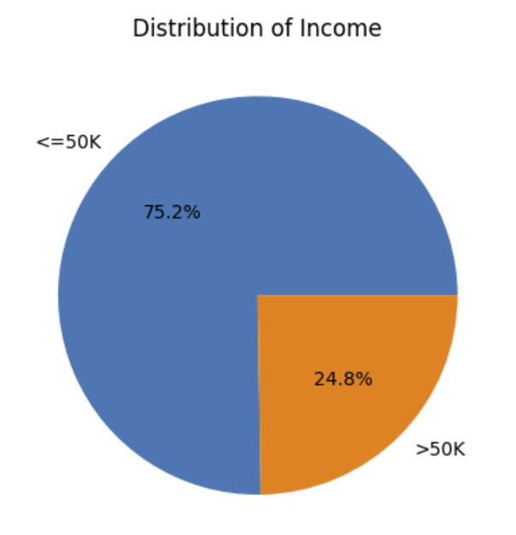
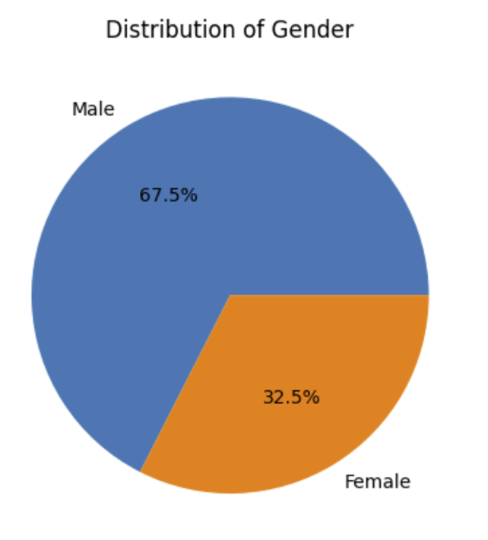
Data Overview
About 75% of the sample data make an income below the $50,000 target
About 67% of the sample data are Males in our data

Slide 10
Model Overview
Classification Problem Type: Binary Classification
Goal: Predict if an individual's income is >$50,000 or <=$50,000 based on demographics and employment features
Target variable: “income” (two classes: <=50K, >50K)
Chosen Model: Neural Network (Multilayer Perceptron - MLP)
MLP captures complex, non-linear relationships between features and target
Benefits: Non-linearity, generalization, flexibility for large datasets

Slide 11
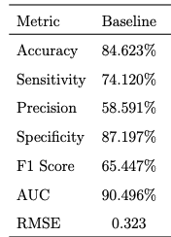
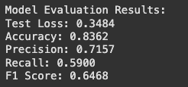
Similar Model vs our Model
Linear Regression
Both Models are predicting whether someone is making $50,000 dollars a year.
In the similar model they chose to use a linear regression Analysis
In our Analysis decided to use a Neural Network
Both models achieve similar accuracy, with Logistic Regression slightly ahead at 84.623% compared to the Neural Networks 83.62%
Neural Network

Slide 12
Model Architecture
Input Layer:
Neuron per feature (both numerical and one-hot encoded categorical)
Hidden Layers:
Two hidden layers with ReLU activation functions
Initial configuration: 64 neurons in the first hidden layer, 32 in the second
Output Layer:
Single neuron with sigmoid activation function
Outputs probability score for binary classification

Slide 13
Model Training Setup
Loss Function: Binary Cross-Entropy for binary classification
Optimizer: Adam (adaptive learning rate optimization)
Combines benefits of RMSProp and Stochastic Gradient Descent
Hyperparameters:
Experiment with batch sizes, epochs, and apply early stopping to prevent overfitting

Slide 14
Model Evaluation Metrics
Evaluation Criteria:
Accuracy: Measures overall correct predictions
Precision: Ratio of true positives to predicted positives
Recall (Sensitivity): Ratio of true positives to actual positives
F1-Score: Balances precision and recall, beneficial for imbalanced datasets

Slide 15
Future
Decision Tree Model:
Will provide us with a way to test a second model to our data
Provides a more transparent and interpretable model
Similar Neural Network Model
Interested to see if we could identify newer data, that is able to achieve similar accuracy

Slide 16
References
Data: https://archive.ics.uci.edu/dataset/2/adult
Similar Model Example: https://escholarship.org/content/qt6d01c9v7/qt6d01c9v7_noSplash_d6307f10bef85009fad51d5837b90bb1.pdf?t=seap4w

